Slide 1

The CONTACT Elements Data Model
A high-level overview
Patrick Simon
CONTACT Software
August 2022

Slide 2
Table of Contents
Classes and Objects
Universal Classification
BOMs & XBOM Manager
Variant Management
Requirements Mgmt.
Workflows

Slide 3
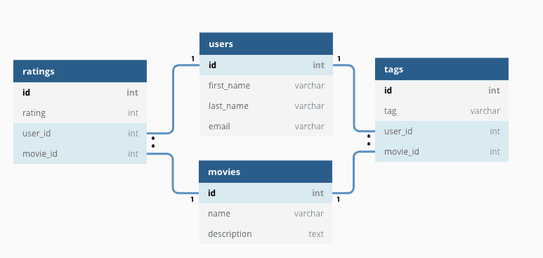
Classes and Objects: Basic Concepts for Relational Databases
Data stored in SQL database
Each table represents a certain object class (Person, Organization, Document, Part, …)
Each column represents an attribute of that class (Person: Name, Address, Phone Number, Employer, …)
Each row represents an object of that class
Tables have primary keys that uniquely identfy each record, and may have foreign keys that establish relationships to other tables

Slide 4
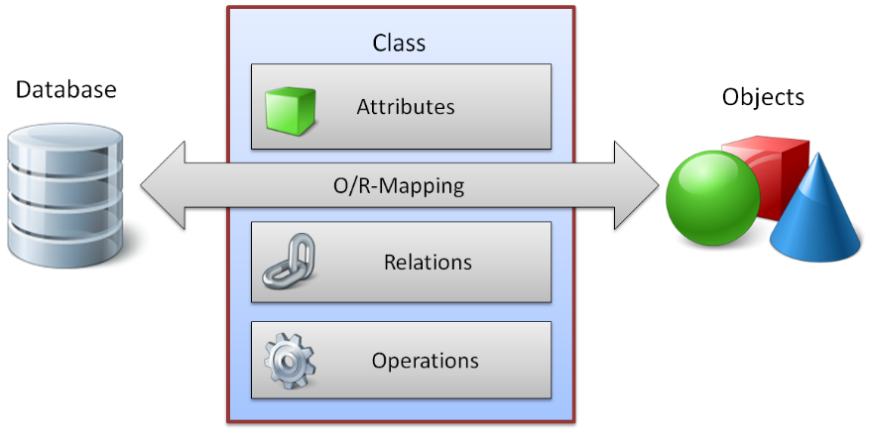
Classes and Objects: The Data Dictionary
The Data Dictionary is used to define classes in CONTACT Elements
It serves as a blueprint for each object
It defines attributes of various types: Char, Int, Float, Date, …
Compiling a DD class creates a corresponding SQL database scheme
The DD allows the definition of relationships to other classes

Slide 5
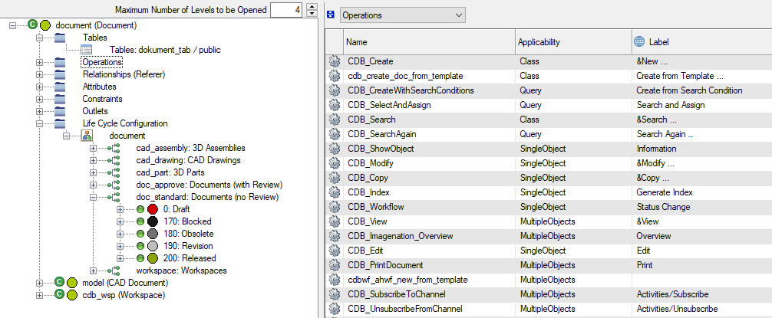
Classes and Objects: Operations
Describe how the user interacts with a class and its objects
Examples: Create, Copy, Search, Modify, Show Object, Status Change, …
Operations are connected to the roles and rights system
Different input dialogs can be configured for each operation
User Exits connect business logic to operations:
„Do X, Y and Z after a new document has been created.“
„Verify the input data before allowing a user to modify object X.“
„Automatically fill the author, department and project number when a new object is being created in a specific context.“
…

Slide 6
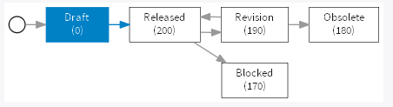
Classes and Objects: Object Lifecycle
Describes the various states that an object can be in
Transitions can be triggered manually (by users with the correct role) or automatically during certain workflows or user exits
Status changes can trigger their own follow-up processes, and determine which users have which rights for the respective object
Different lifecycles for different sub-categories of a class are possible

Slide 7
Table of Contents
Classes and Objects
Universal Classification
BOMs & XBOM Manager
Variant Management
Requirements Mgmt.
Workflows

Slide 8
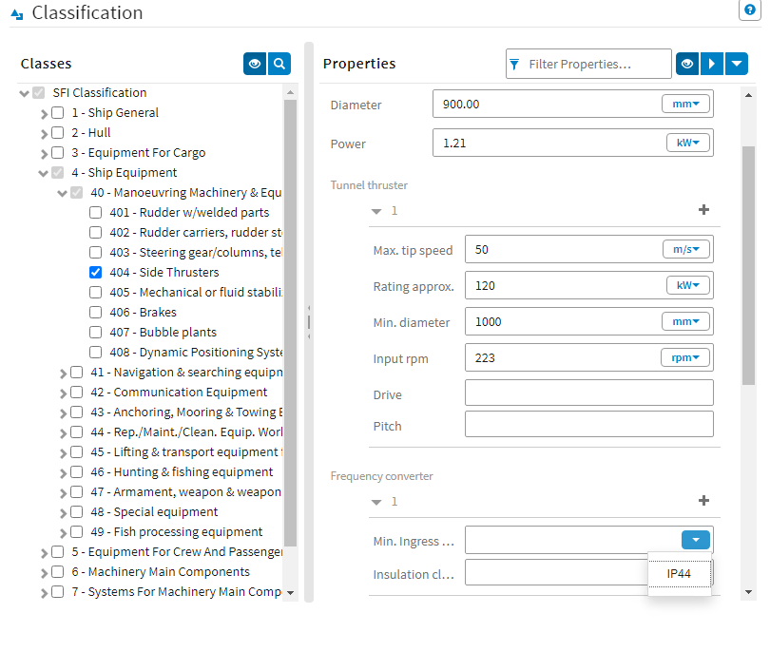
Universal Classification: Basic Concepts
Allows the classification of all objects in the system for additional description, or separation or grouping
Extends the data model, but only where needed
Highly flexible
One UC class can be used for multiple data dictionary classes
Does not modify the database schema
Can be administrated by certain user groups

Slide 9
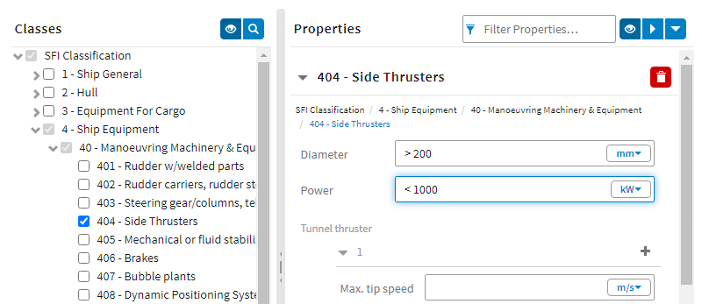
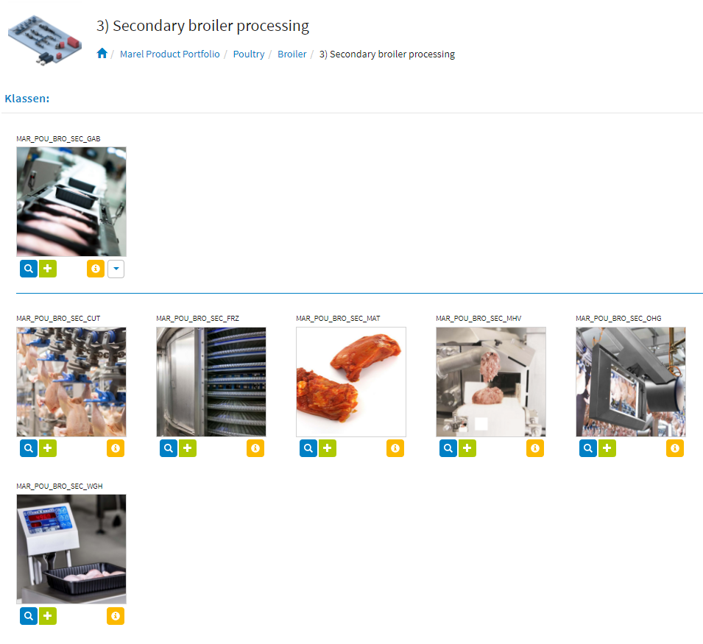
Universal Classification: Classes and Properties
Any object can be classified with one or multiple Universal Classification classes
Each UC class has a list of pre-defined class properties, for which an object can have its own property values
The classified search allows users to find objects belonging to certain UC classes, and with specific property values within these classes
The object plan allows for easy navigation and search based on the UC structure

Slide 10
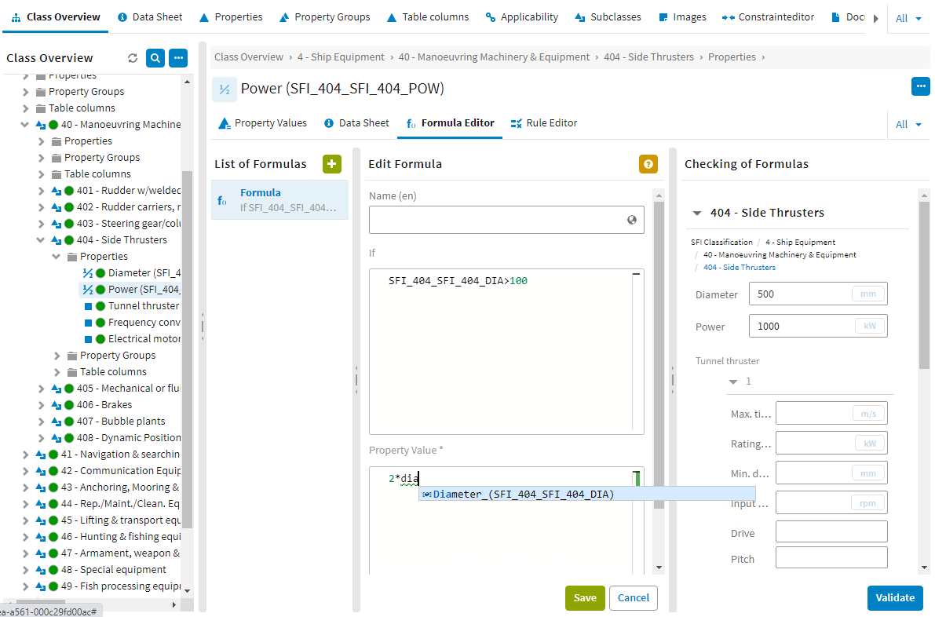
Universal Classification: Rules, Formulas and Constraints
Universal Classification brings certain features out of the box that would usually need to be customized through user exits:
Rules: set certain class properties to mandatory/optional and editable/read-only based on other property values
Formulas: automatically fill property values based on other property values
Constraints: restrict users from assigning specific property values or combinations

Slide 11
Table of Contents
Classes and Objects
Universal Classification
BOMs & XBOM Manager
Variant Management
Requirements Mgmt.
Workflows

Slide 12
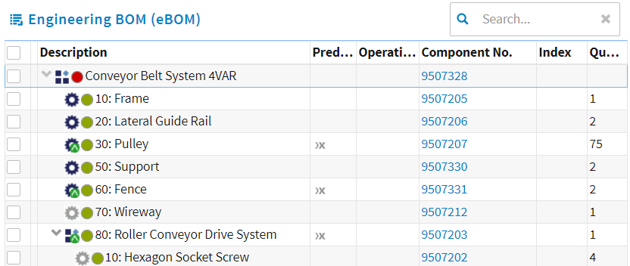
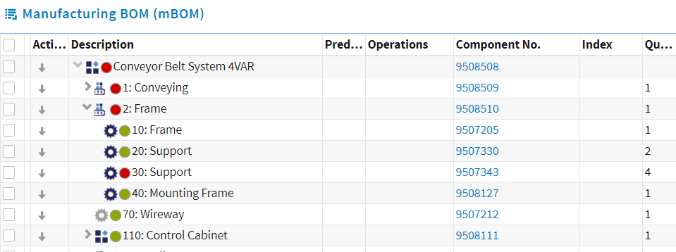
BOMs and XBOM Manager: Basic Concepts
The Bill of Material (BOM) is a key component of CONTACT Element‘s Virtual Product module
It describes the structure of a whole product, or one of its various sub-assemblies
eBOM reflects how the product has been designed
mBOM reflects the stages involved in assembly
Takes into account logistical parts, pseudo-parts, logistical units; integration of lubricants, shipping protection, …

Slide 13
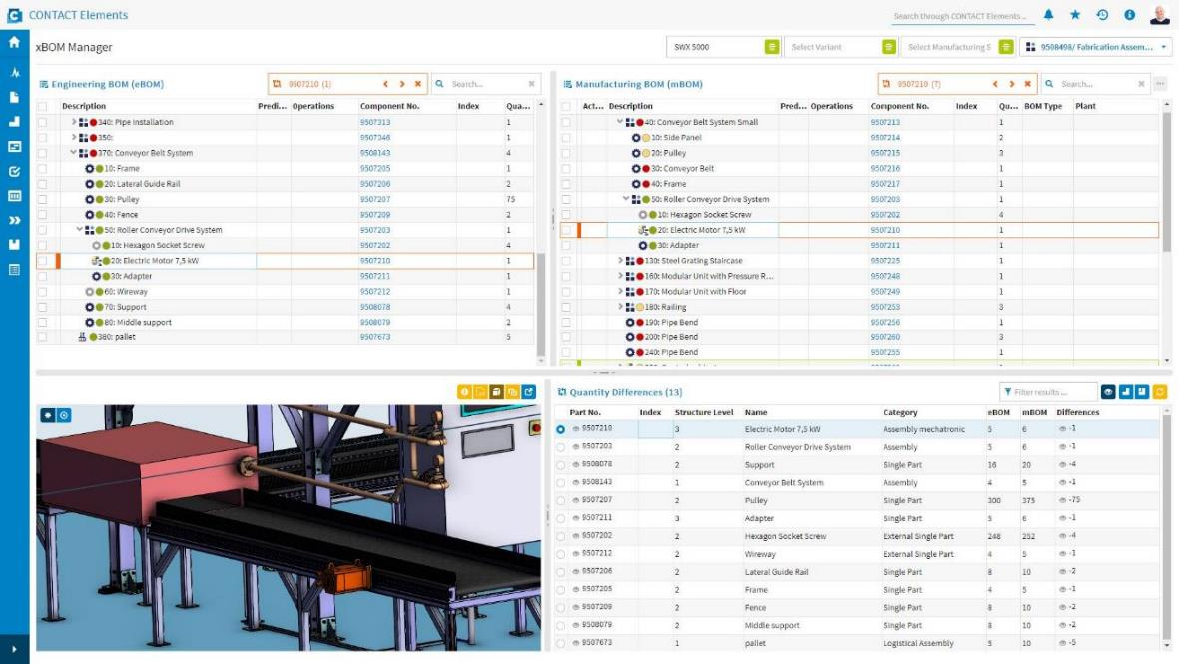
BOMs and XBOM Manager: Features of the XBOM Manager
The XBOM Manager offers side-by-side comparison between eBOMs, mBOMs, other BOM types
Automatic calculation of quantity differences
Highlighting of matching positions (and components in 3D model)
Easy and intuitive creation and maintenance of derived BOMs

Slide 14
Table of Contents
Classes and Objects
Universal Classification
BOMs & XBOM Manager
Variant Management
Requirements Mgmt.
Workflows

Slide 15
Variant Management: Basic Concepts
Product
Variant Management combines the worlds of BOM Management and Universal Classification
A product‘s maximum BOM contains all possible parts and assemblies
A UC-based variability model describes the variant space
Selection rules define which of these variable parts are instantiated for each specific variant
Max. BOM
Variability model
BOM positions
Universal Classification
Classes
Parts
Properties
Property values
Constraints
Formulas
(Rules)
Selection rules

Slide 16
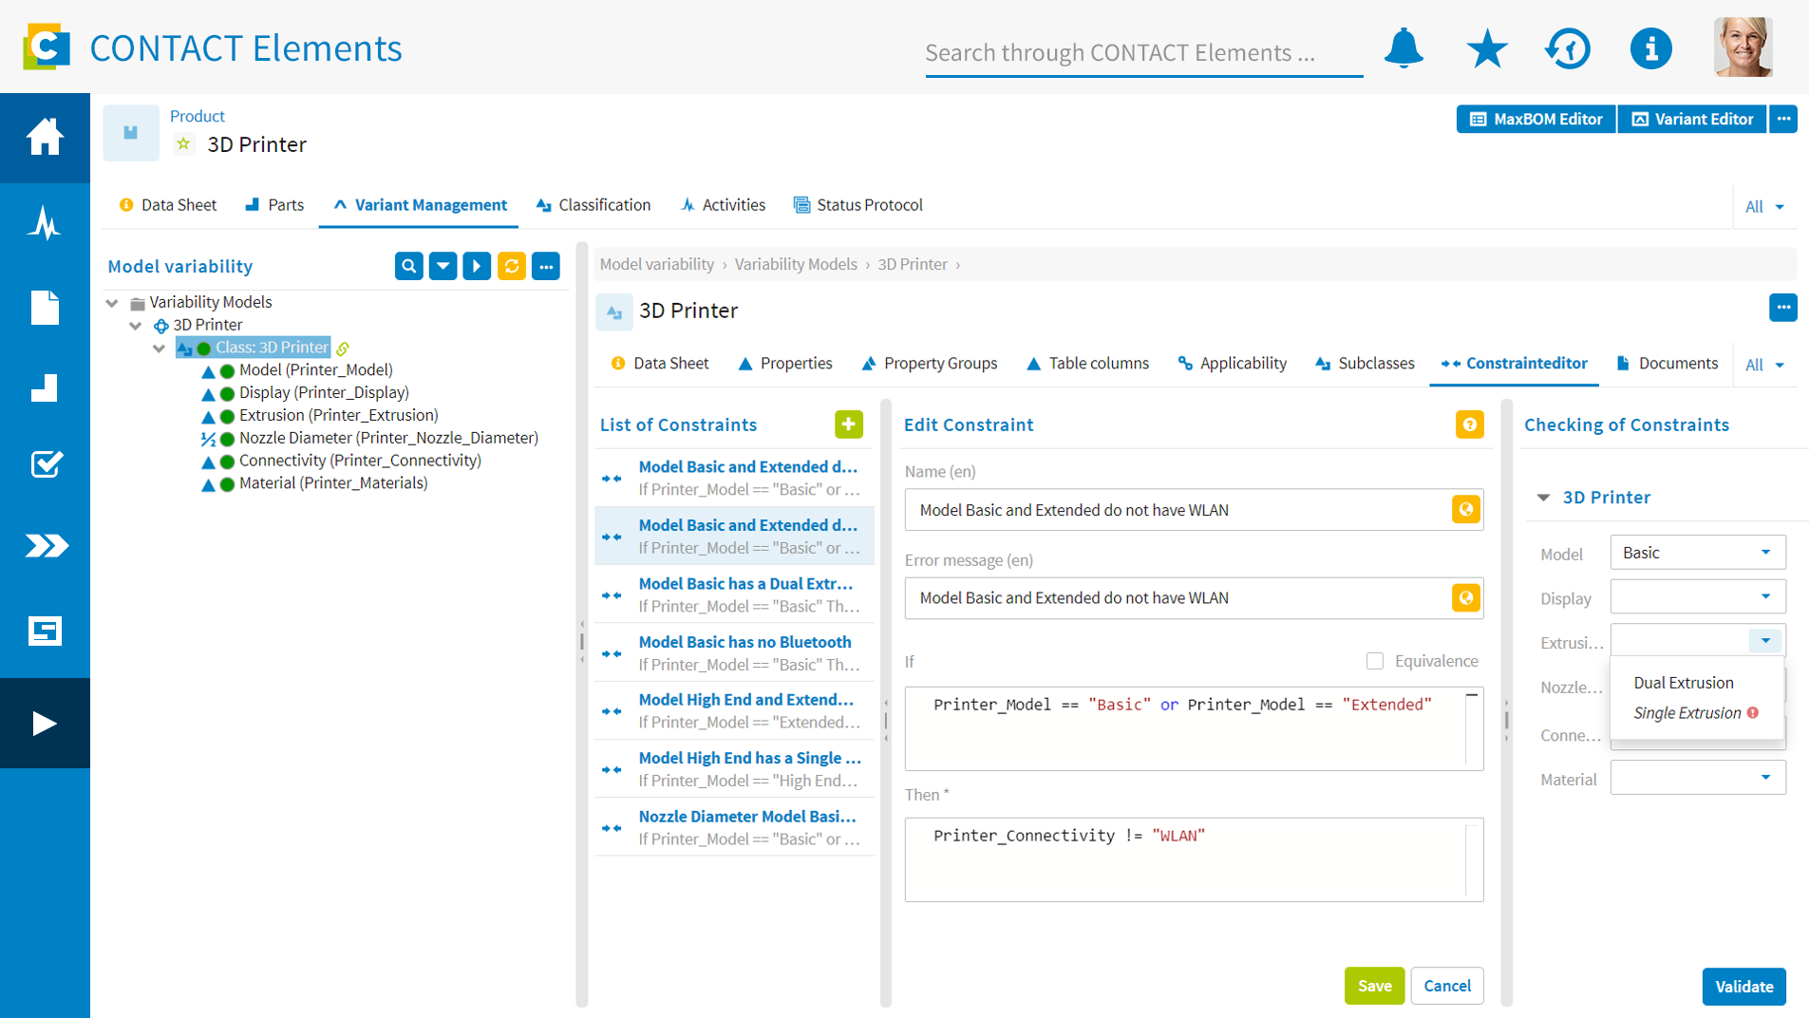
Variant Management: Variability Model
1
Create properties and their values
2
Easily define and validate constraints in the Constraint Editor

Slide 17
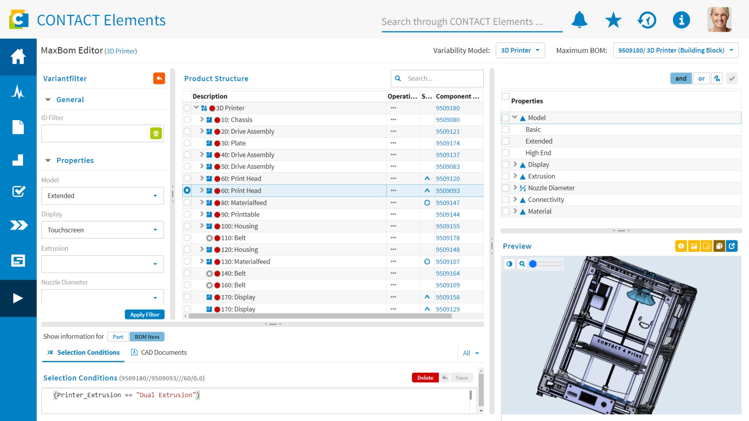
Variant Management: MaxBOM Editor
1
Variant filter for validating regulation of the maximum BOM
2
Definition of the selection conditions via text input with auto-completion ...
3
... or with a few clicks
4
Visual support thanks to the integration of 3D preview

Slide 18
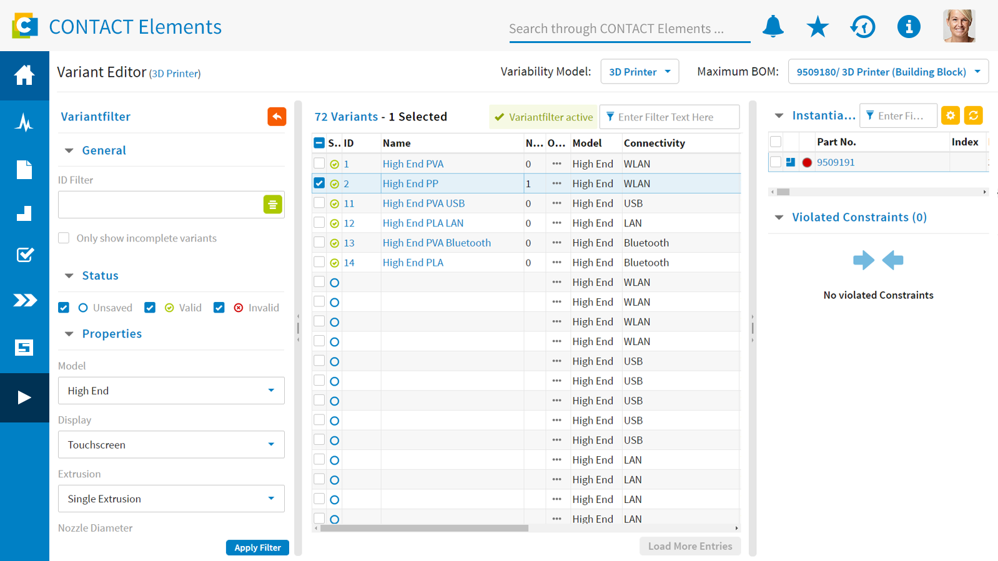
Variant Management: Variant Editor
1
Filter options for quickly limiting the variant space
2
Overview of a variant’s instantiated parts
3
Entire variant space as a result of properties and constraints, variants can be saved, named, and instantiated from this view

Slide 19
Table of Contents
Classes and Objects
Universal Classification
BOMs & XBOM Manager
Variant Management
Requirements Mgmt.
Workflows

Slide 20
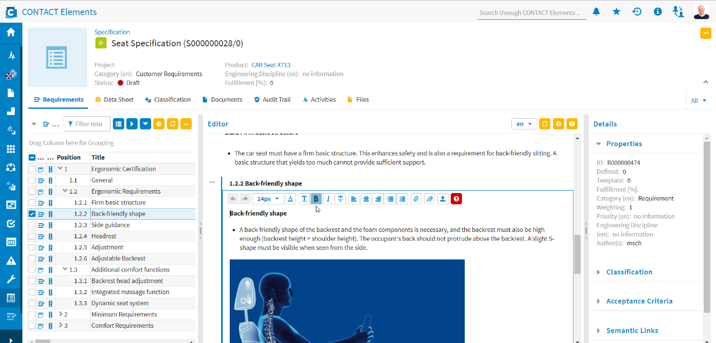
Requirements Management: Basic Concepts
Create and edit web-based specifications, their requirements and acceptance criteria
Add layouts and image information
Classification and evaluation of requirements
Link requirements to acceptance criteria

Slide 21
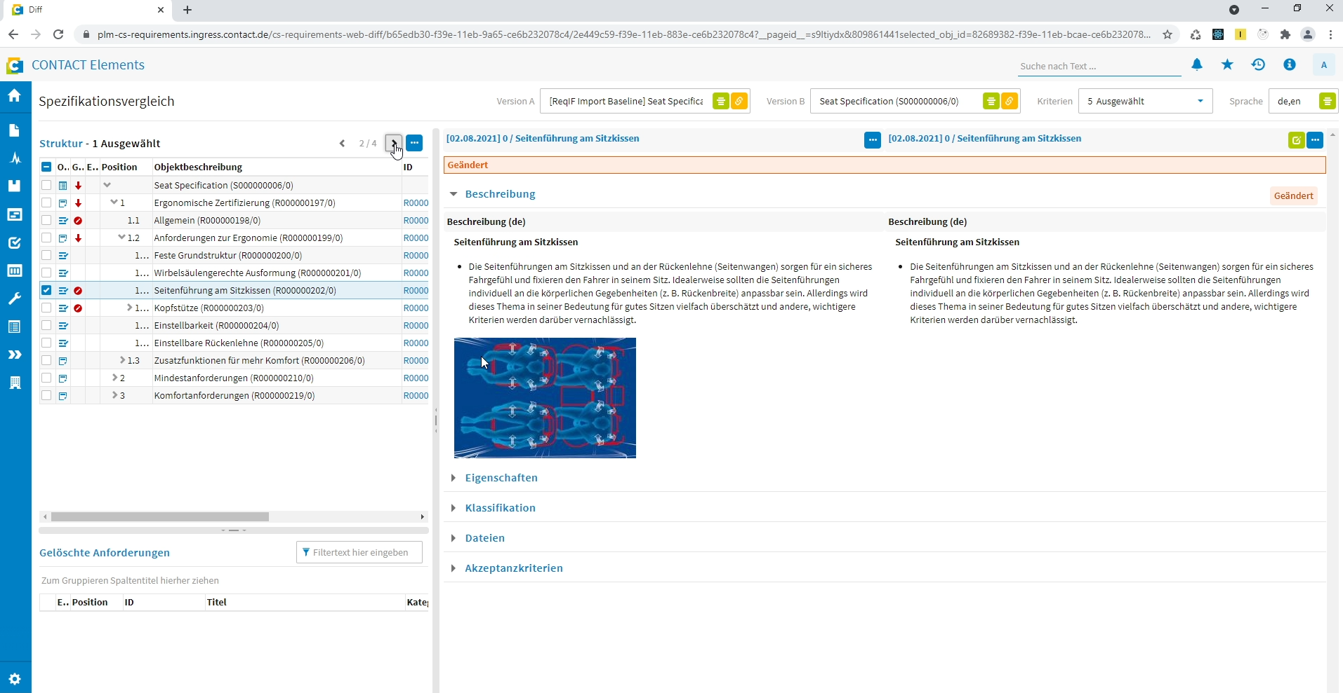
Requirements Management: Baselining
Comparison between a baseline and the current configuration
Overview of differences between compared configurations
Detailed view of a selected difference

Slide 22
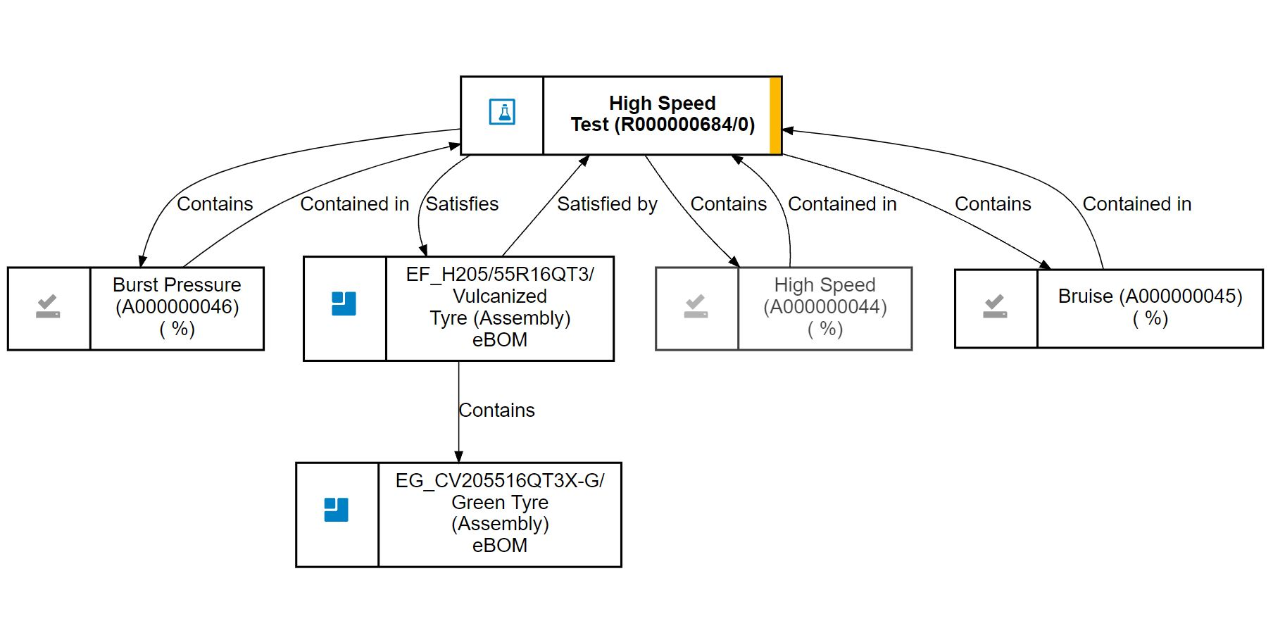
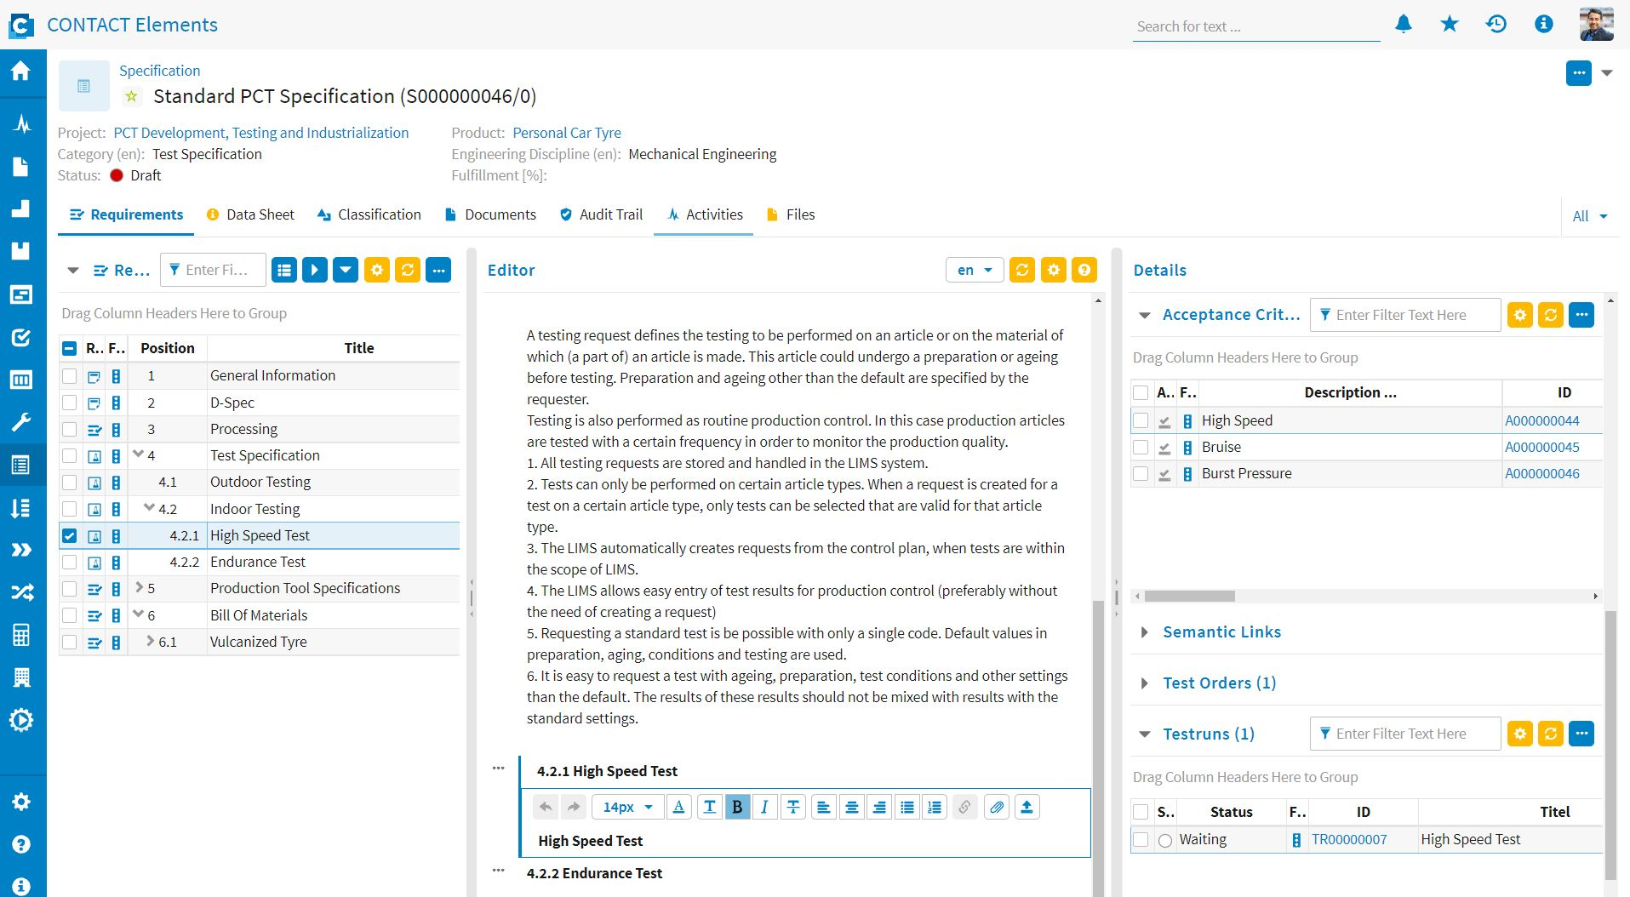





Slides Mayuresh V&V

Slide 23
Table of Contents
Classes and Objects
Universal Classification
BOMs & XBOM Manager
Variant Management
Requirements Mgmt.
Workflows

Slide 24
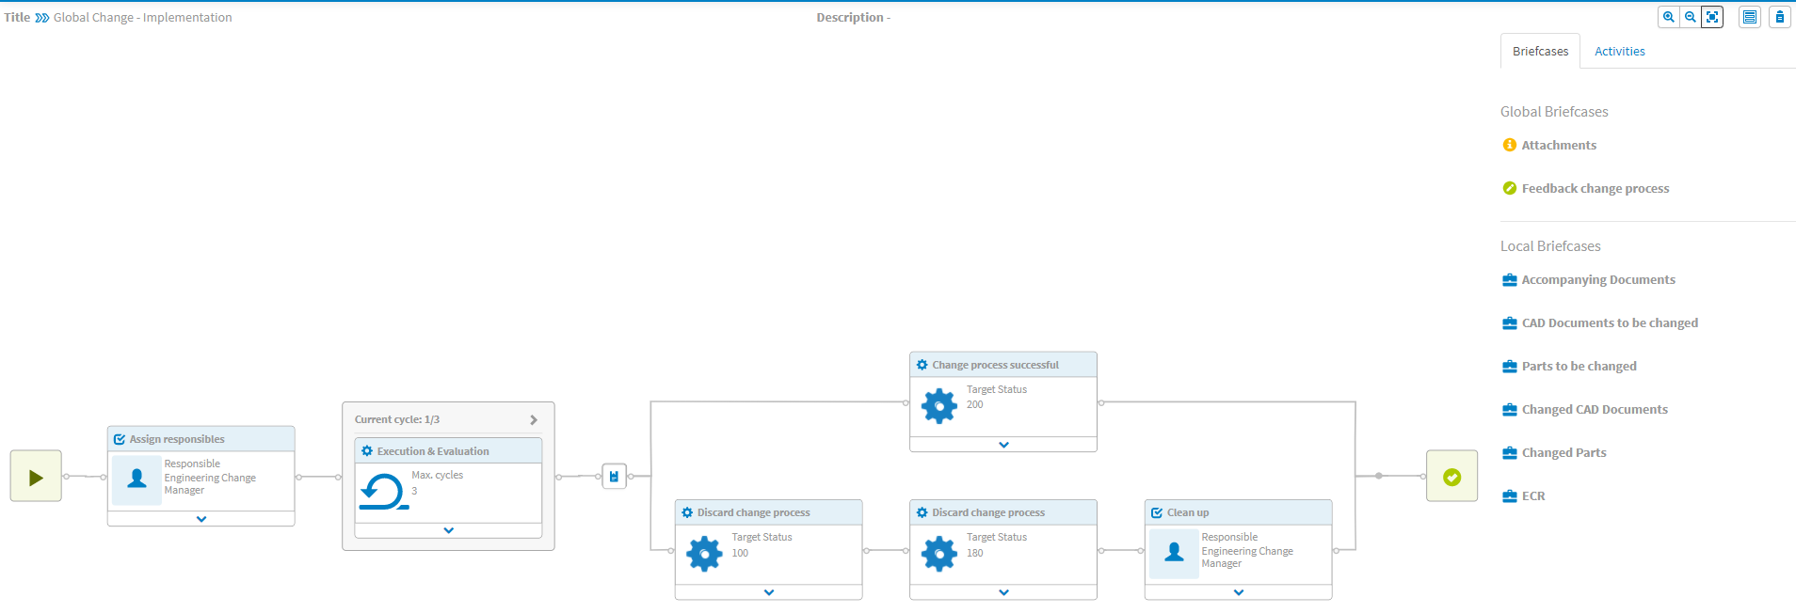
Workflows: Basic Concepts
Workflows are used to model business processes in CONTACT Elements
They can contain (among others):
Standardized tasks (Review, Approval)
Notification of users/user groups
Status changes
Forms that need to be filled out
Workflow Designer: graphical interface
Workflow Tasks show up in „My Tasks“

Slide 25
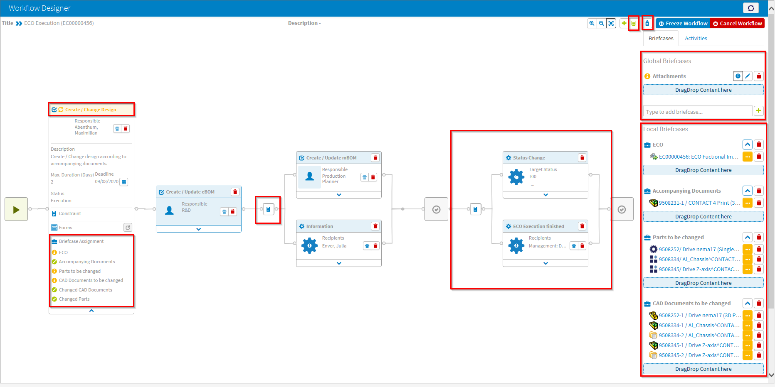
Task Information – Status in Header
Completion tasks – directly after the workflow end
Constraints
System task
Local briefcases

Slide 26
Questions

Slide 27


Thank You!
www.contact-software.com
energizing great minds

